Slide 1
Chapter 25 Binary Search Trees

Slide 2
Trees
Make Money Fast!
Stock Fraud
Ponzi Scheme
Bank Robbery

Slide 3
Binary Trees
A list, stack, or queue is a linear structure that consists of a sequence of elements. A binary tree is a hierarchical structure. It is either empty or consists of an element, called the root, and two distinct binary trees, called the left subtree and right subtree.

Slide 4
Binary Tree Terms
The root of left (right) subtree of a node is called a left (right) child of the node.
A node without children is called a leaf.
A special type of binary tree called a binary search tree is often useful.
A binary search tree (with no duplicate elements) has the property that for every node in the tree the value of any node in its left subtree is less than the value of the node and the value of any node in its right subtree is greater than the value of the node.

Slide 5
Why Binary Search Trees
Often used to implement lookup tables and dynamic sets
Always sorted so look up is more efficient than in many other data structures
Other types of trees used for storing router –tables in network routers, compression algorithms, cryptography, parsing and more

Slide 6
Arithmetic Expression Tree
Binary tree associated with an arithmetic expression
internal nodes: operators
external nodes: operands
Example: arithmetic expression tree for the expression (2 × (a − 1) + (3 × b))
+
×
×
2
−
3
b
a
1

Slide 7
Decision Tree
Binary tree associated with a decision process
internal nodes: questions with yes/no answer
external nodes: decisions
Example: dining decision
Want a fast meal?
Yes
No
How about coffee?
On expense account?
Yes
No
Yes
No
Starbucks
Spike’s
Al Forno
Café Paragon

Slide 8
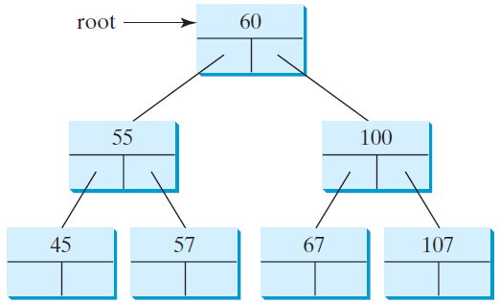
Representing Binary Trees
A binary tree can be represented using a set of linked nodes. Each node contains a value and two links named left and right that reference the left child and right child, respectively, as shown in Figure 25.2.
class TreeNode<E> {
E element;
TreeNode<E> left;
TreeNode<E> right;
public TreeNode(E o) {
element = o;
}
}

Slide 9
Searching an Element in a Binary Search Tree
public boolean search(E element) {
TreeNode<E> current = root; // Start from the root
while (current != null)
if (element < current.element) {
current = current.left; // Go left
}
else if (element > current.element) {
current = current.right; // Go right
}
else // Element matches current.element
return true; // Element is found
return false; // Element is not in the tree
}

Slide 10
Inserting an Element to a Binary Search Tree
If a binary tree is empty, create a root node with the new element.
Otherwise, locate the parent node for the new element node.
If the new element is less than the parent element, the node for the new element becomes the left child of the parent.
If the new element is greater than the parent element, the node for the new element becomes the right child of the parent.
Here is the algorithm:

Slide 11
Inserting an Element to a Binary Tree
if (root == null)
root = new TreeNode(element);
else {
// Locate the parent node
current = root;
while (current != null)
if (element value < the value in current.element) {
parent = current;
current = current.left;
}
else if (element value > the value in current.element) {
parent = current;
current = current.right;
}
else
return false; // Duplicate node not inserted
// Create the new node and attach it to the parent node
if (element < parent.element)
parent.left = new TreeNode(elemenet);
else
parent.right = new TreeNode(elemenet);
return true; // Element inserted
}
Insert 101 into the following tree.

Slide 12
Trace Inserting 101 into the following tree
if (root == null)
root = new TreeNode(element);
else {
// Locate the parent node
current = root;
while (current != null)
if (element value < the value in current.element) {
parent = current;
current = current.left;
}
else if (element value > the value in current.element) {
parent = current;
current = current.right;
}
else
return false; // Duplicate node not inserted
// Create the new node and attach it to the parent node
if (element < parent.element)
parent.left = new TreeNode(elemenet);
else
parent.right = new TreeNode(elemenet);
return true; // Element inserted
}
Insert 101 into the following tree.

Slide 13
Trace Inserting 101 into the following tree, cont.
if (root == null)
root = new TreeNode(element);
else {
// Locate the parent node
current = root;
while (current != null)
if (element value < the value in current.element) {
parent = current;
current = current.left;
}
else if (element value > the value in current.element) {
parent = current;
current = current.right;
}
else
return false; // Duplicate node not inserted
// Create the new node and attach it to the parent node
if (element < parent.element)
parent.left = new TreeNode(elemenet);
else
parent.right = new TreeNode(elemenet);
return true; // Element inserted
}
Insert 101 into the following tree.

Slide 14
Trace Inserting 101 into the following tree, cont.
if (root == null)
root = new TreeNode(element);
else {
// Locate the parent node
current = root;
while (current != null)
if (element value < the value in current.element) {
parent = current;
current = current.left;
}
else if (element value > the value in current.element) {
parent = current;
current = current.right;
}
else
return false; // Duplicate node not inserted
// Create the new node and attach it to the parent node
if (element < parent.element)
parent.left = new TreeNode(elemenet);
else
parent.right = new TreeNode(elemenet);
return true; // Element inserted
}
Insert 101 into the following tree.

Slide 15
Trace Inserting 101 into the following tree, cont.
if (root == null)
root = new TreeNode(element);
else {
// Locate the parent node
current = root;
while (current != null)
if (element value < the value in current.element) {
parent = current;
current = current.left;
}
else if (element value > the value in current.element) {
parent = current;
current = current.right;
}
else
return false; // Duplicate node not inserted
// Create the new node and attach it to the parent node
if (element < parent.element)
parent.left = new TreeNode(elemenet);
else
parent.right = new TreeNode(elemenet);
return true; // Element inserted
}
Insert 101 into the following tree.
101 < 60?

Slide 16
Trace Inserting 101 into the following tree, cont.
if (root == null)
root = new TreeNode(element);
else {
// Locate the parent node
current = root;
while (current != null)
if (element value < the value in current.element) {
parent = current;
current = current.left;
}
else if (element value > the value in current.element) {
parent = current;
current = current.right;
}
else
return false; // Duplicate node not inserted
// Create the new node and attach it to the parent node
if (element < parent.element)
parent.left = new TreeNode(elemenet);
else
parent.right = new TreeNode(elemenet);
return true; // Element inserted
}
Insert 101 into the following tree.
101 > 60?

Slide 17
Trace Inserting 101 into the following tree, cont.
if (root == null)
root = new TreeNode(element);
else {
// Locate the parent node
current = root;
while (current != null)
if (element value < the value in current.element) {
parent = current;
current = current.left;
}
else if (element value > the value in current.element) {
parent = current;
current = current.right;
}
else
return false; // Duplicate node not inserted
// Create the new node and attach it to the parent node
if (element < parent.element)
parent.left = new TreeNode(elemenet);
else
parent.right = new TreeNode(elemenet);
return true; // Element inserted
}
Insert 101 into the following tree.
101 > 60 true

Slide 18
Trace Inserting 101 into the following tree, cont.
if (root == null)
root = new TreeNode(element);
else {
// Locate the parent node
current = root;
while (current != null)
if (element value < the value in current.element) {
parent = current;
current = current.left;
}
else if (element value > the value in current.element) {
parent = current;
current = current.right;
}
else
return false; // Duplicate node not inserted
// Create the new node and attach it to the parent node
if (element < parent.element)
parent.left = new TreeNode(elemenet);
else
parent.right = new TreeNode(elemenet);
return true; // Element inserted
}
Insert 101 into the following tree.
101 > 60 true

Slide 19
Trace Inserting 101 into the following tree, cont.
if (root == null)
root = new TreeNode(element);
else {
// Locate the parent node
current = root;
while (current != null)
if (element value < the value in current.element) {
parent = current;
current = current.left;
}
else if (element value > the value in current.element) {
parent = current;
current = current.right;
}
else
return false; // Duplicate node not inserted
// Create the new node and attach it to the parent node
if (element < parent.element)
parent.left = new TreeNode(elemenet);
else
parent.right = new TreeNode(elemenet);
return true; // Element inserted
}
Insert 101 into the following tree.
101 > 60 true

Slide 20
Trace Inserting 101 into the following tree, cont.
if (root == null)
root = new TreeNode(element);
else {
// Locate the parent node
current = root;
while (current != null)
if (element value < the value in current.element) {
parent = current;
current = current.left;
}
else if (element value > the value in current.element) {
parent = current;
current = current.right;
}
else
return false; // Duplicate node not inserted
// Create the new node and attach it to the parent node
if (element < parent.element)
parent.left = new TreeNode(elemenet);
else
parent.right = new TreeNode(elemenet);
return true; // Element inserted
}
Insert 101 into the following tree.
101 > 100 false

Slide 21
Trace Inserting 101 into the following tree, cont.
if (root == null)
root = new TreeNode(element);
else {
// Locate the parent node
current = root;
while (current != null)
if (element value < the value in current.element) {
parent = current;
current = current.left;
}
else if (element value > the value in current.element) {
parent = current;
current = current.right;
}
else
return false; // Duplicate node not inserted
// Create the new node and attach it to the parent node
if (element < parent.element)
parent.left = new TreeNode(elemenet);
else
parent.right = new TreeNode(elemenet);
return true; // Element inserted
}
Insert 101 into the following tree.
101 > 100 true

Slide 22
Trace Inserting 101 into the following tree, cont.
if (root == null)
root = new TreeNode(element);
else {
// Locate the parent node
current = root;
while (current != null)
if (element value < the value in current.element) {
parent = current;
current = current.left;
}
else if (element value > the value in current.element) {
parent = current;
current = current.right;
}
else
return false; // Duplicate node not inserted
// Create the new node and attach it to the parent node
if (element < parent.element)
parent.left = new TreeNode(elemenet);
else
parent.right = new TreeNode(elemenet);
return true; // Element inserted
}
Insert 101 into the following tree.
101 > 100 true

Slide 23
Trace Inserting 101 into the following tree, cont.
if (root == null)
root = new TreeNode(element);
else {
// Locate the parent node
current = root;
while (current != null)
if (element value < the value in current.element) {
parent = current;
current = current.left;
}
else if (element value > the value in current.element) {
parent = current;
current = current.right;
}
else
return false; // Duplicate node not inserted
// Create the new node and attach it to the parent node
if (element < parent.element)
parent.left = new TreeNode(elemenet);
else
parent.right = new TreeNode(elemenet);
return true; // Element inserted
}
Insert 101 into the following tree.
101 > 100 true

Slide 24
Trace Inserting 101 into the following tree, cont.
if (root == null)
root = new TreeNode(element);
else {
// Locate the parent node
current = root;
while (current != null)
if (element value < the value in current.element) {
parent = current;
current = current.left;
}
else if (element value > the value in current.element) {
parent = current;
current = current.right;
}
else
return false; // Duplicate node not inserted
// Create the new node and attach it to the parent node
if (element < parent.element)
parent.left = new TreeNode(elemenet);
else
parent.right = new TreeNode(elemenet);
return true; // Element inserted
}
Insert 101 into the following tree.
101 > 100 true

Slide 25
Trace Inserting 101 into the following tree, cont.
if (root == null)
root = new TreeNode(element);
else {
// Locate the parent node
current = root;
while (current != null)
if (element value < the value in current.element) {
parent = current;
current = current.left;
}
else if (element value > the value in current.element) {
parent = current;
current = current.right;
}
else
return false; // Duplicate node not inserted
// Create the new node and attach it to the parent node
if (element < parent.element)
parent.left = new TreeNode(elemenet);
else
parent.right = new TreeNode(elemenet);
return true; // Element inserted
}
Insert 101 into the following tree.
101 < 107 true

Slide 26
Trace Inserting 101 into the following tree, cont.
if (root == null)
root = new TreeNode(element);
else {
// Locate the parent node
current = root;
while (current != null)
if (element value < the value in current.element) {
parent = current;
current = current.left;
}
else if (element value > the value in current.element) {
parent = current;
current = current.right;
}
else
return false; // Duplicate node not inserted
// Create the new node and attach it to the parent node
if (element < parent.element)
parent.left = new TreeNode(elemenet);
else
parent.right = new TreeNode(elemenet);
return true; // Element inserted
}
Insert 101 into the following tree.
101 < 107 true

Slide 27
Trace Inserting 101 into the following tree, cont.
if (root == null)
root = new TreeNode(element);
else {
// Locate the parent node
current = root;
while (current != null)
if (element value < the value in current.element) {
parent = current;
current = current.left;
}
else if (element value > the value in current.element) {
parent = current;
current = current.right;
}
else
return false; // Duplicate node not inserted
// Create the new node and attach it to the parent node
if (element < parent.element)
parent.left = new TreeNode(elemenet);
else
parent.right = new TreeNode(elemenet);
return true; // Element inserted
}
Insert 101 into the following tree.
101 < 107 true

Slide 28
Trace Inserting 101 into the following tree, cont.
if (root == null)
root = new TreeNode(element);
else {
// Locate the parent node
current = root;
while (current != null)
if (element value < the value in current.element) {
parent = current;
current = current.left;
}
else if (element value > the value in current.element) {
parent = current;
current = current.right;
}
else
return false; // Duplicate node not inserted
// Create the new node and attach it to the parent node
if (element < parent.element)
parent.left = new TreeNode(elemenet);
else
parent.right = new TreeNode(elemenet);
return true; // Element inserted
}
Insert 101 into the following tree.
current is null now

Slide 29
Trace Inserting 101 into the following tree, cont.
if (root == null)
root = new TreeNode(element);
else {
// Locate the parent node
current = root;
while (current != null)
if (element value < the value in current.element) {
parent = current;
current = current.left;
}
else if (element value > the value in current.element) {
parent = current;
current = current.right;
}
else
return false; // Duplicate node not inserted
// Create the new node and attach it to the parent node
if (element < parent.element)
parent.left = new TreeNode(elemenet);
else
parent.right = new TreeNode(elemenet);
return true; // Element inserted
}
Insert 101 into the following tree.
101 < 107 true

Slide 30
Trace Inserting 101 into the following tree, cont.
if (root == null)
root = new TreeNode(element);
else {
// Locate the parent node
current = root;
while (current != null)
if (element value < the value in current.element) {
parent = current;
current = current.left;
}
else if (element value > the value in current.element) {
parent = current;
current = current.right;
}
else
return false; // Duplicate node not inserted
// Create the new node and attach it to the parent node
if (element < parent.element)
parent.left = new TreeNode(elemenet);
else
parent.right = new TreeNode(elemenet);
return true; // Element inserted
}
Insert 101 into the following tree.
101 < 107 true

Slide 31
Trace Inserting 101 into the following tree, cont.
if (root == null)
root = new TreeNode(element);
else {
// Locate the parent node
current = root;
while (current != null)
if (element value < the value in current.element) {
parent = current;
current = current.left;
}
else if (element value > the value in current.element) {
parent = current;
current = current.right;
}
else
return false; // Duplicate node not inserted
// Create the new node and attach it to the parent node
if (element < parent.element)
parent.left = new TreeNode(elemenet);
else
parent.right = new TreeNode(elemenet);
return true; // Element inserted
}
Insert 101 into the following tree.
101 < 107 true

Slide 32
Inserting 59 into the Tree
if (root == null)
root = new TreeNode(element);
else {
// Locate the parent node
current = root;
while (current != null)
if (element value < the value in current.element) {
parent = current;
current = current.left;
}
else if (element value > the value in current.element) {
parent = current;
current = current.right;
}
else
return false; // Duplicate node not inserted
// Create the new node and attach it to the parent node
if (element < parent.element)
parent.left = new TreeNode(elemenet);
else
parent.right = new TreeNode(elemenet);
return true; // Element inserted
}

Slide 33
Tree Traversal
Tree traversal is the process of visiting each node in the tree exactly once.
There are several ways to traverse a tree.
This section presents
inorder,
preorder,
postorder,
depth-first, and
breadth-first traversals.
.

Slide 34
In-Order Traversal
The inorder traversal is to visit the left subtree of the current node first recursively
, then the current node itself,
and finally the right subtree of the current node recursively

Slide 35
Print Arithmetic Expressions
Specialization of an inorder traversal
print operand or operator when visiting node
print “(“ before traversing left subtree
print “)“ after traversing right subtree
Algorithm printExpression(v)
if hasLeft (v) print(“(’’)
inOrder (left(v))
print(v.element ())
if hasRight (v)
inOrder (right(v))
print (“)’’)
+
×
×
2
−
3
b
((2 × (a − 1)) + (3 × b))
a
1

Slide 36
Post-order Traversal
The postorder traversal is to visit the left subtree of the current node first,
then the right subtree of the current node, and
finally the current node itself.

Slide 37
Evaluate Arithmetic Expressions
Specialization of a postorder traversal
recursive method returning the value of a subtree
when visiting an internal node, combine the values of the subtrees
Algorithm evalExpr(v)
if isExternal (v)
return v.element ()
else
x ← evalExpr(leftChild (v))
y ← evalExpr(rightChild (v))
◊ ← operator stored at v
return x ◊ y
+
×
×
2
−
3
2
5
1

Slide 38
Pre-Order Traversal
The preorder traversal is to visit the current node first,
Then the left subtree of the current node recursively,
and finally the right subtree of the current node recursively.

Slide 39
Breadth-first.
The breadth-first traversal is to visit the nodes level by level.
First visit the root, t
hen all children of the root from left to right,
then grandchildren of the root from left to right, and so on.
For example, in the tree in Figure 25.2, the inorder is 45 55 57 59 60 67 100 101 107. The postorder is 45 59 57 55 67 101 107 100 60. The preorder is 60 55 45 57 59 100 67 107 101. The breadth-first traversal is 60 55 100 45 57 67 107 59 101.

Slide 40
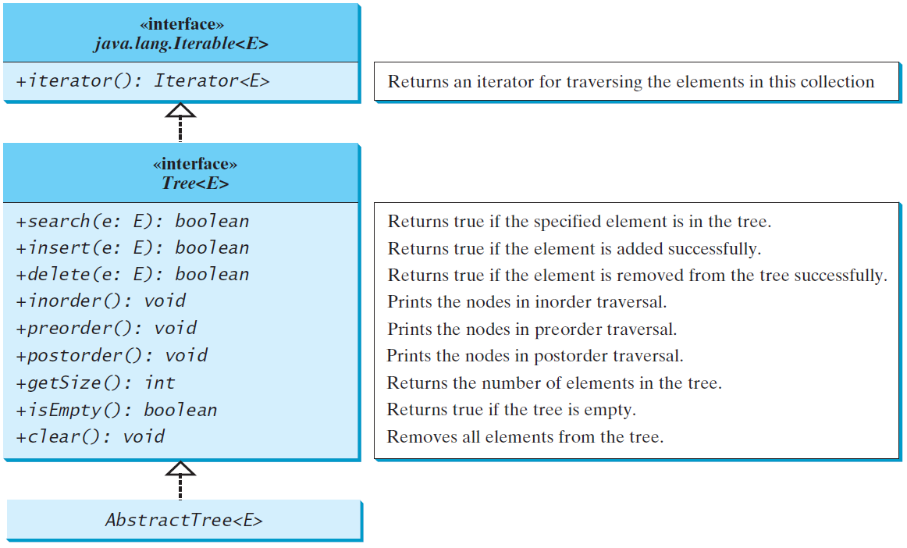
The Tree Interface
The Tree interface defines common operations for trees.
The AbstractTree class partially implements Tree.
Tree
AbstractTree

Slide 41
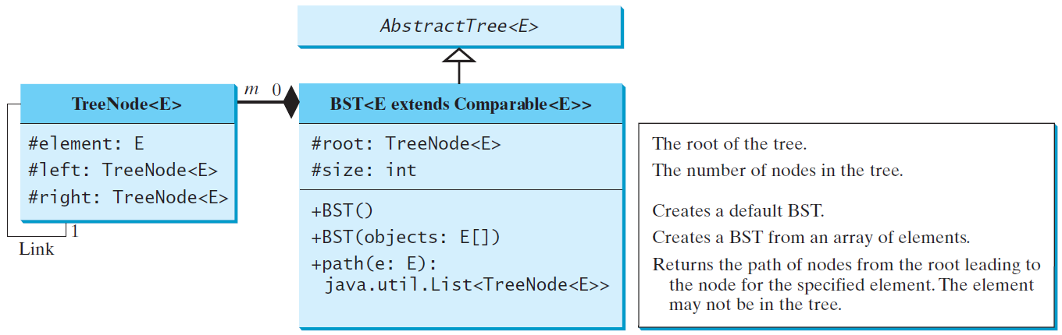
The BST Class
Let’s define the binary tree class, named BST with A concrete BST class can be defined to extend AbstractTree.
BST

Slide 42
Example: Using Binary Trees
Write a program that creates a binary tree using BST. Add strings into the binary tree and traverse the tree in inorder, postorder, and preorder.
TestBST
Run

Slide 43
Tree After Insertions
Inorder: Adam, Daniel George, Jones, Michael, Peter, Tom
Postorder: Daniel Adam, Jones, Peter, Tom, Michael, George
Preorder: George, Adam, Daniel, Michael, Jones, Tom, Peter

Slide 44
Deleting Elements in a Binary Search Tree
To delete an element from a binary tree, you need to first locate the node that contains the element and also its parent node.
Let current point to the node that contains the element in the binary tree
and parent point to the parent of the current node.
The current node may be a left child or a right child of the parent node.
There are two cases to consider:

Slide 45
Deleting Elements in a Binary Search Tree
Case 1: The current node does not have a left child, as shown in this figure (a). Simply connect the parent with the right child of the current node, as shown in this figure (b).

Slide 46
Deleting Elements in a Binary Search Tree
For example, to delete node 10 in Figure 25.9a. Connect the parent of node 10 with the right child of node 10, as shown in Figure 25.9b.

Slide 47
Deleting Elements in a Binary Search Tree
Case 2:
The current node has a left child.
Let rightMost point to the node that contains the largest element in the left subtree of the current node and
parentOfRightMost point to the parent node of the rightMost node, as shown in Figure 25.10a.
Note that the rightMost node cannot have a right child, but may have a left child.
Replace the element value in the current node with the one in the rightMost node, connect the parentOfRightMost node with the left child of the rightMost node, and delete the rightMost node, as shown in Figure 25.10b.

Slide 48
Deleting Elements in a Binary Search Tree
Case 2 diagram

Slide 49
Deleting Elements in a Binary Search Tree
Case 2 example, delete 20

Slide 50
Examples

Slide 51
Examples

Slide 52
Examples
TestBSTDelete
Run

Slide 53
binary tree time complexity
It is obvious that the time complexity for the inorder, preorder, and postorder is O(n), since each node is traversed only once. The time complexity for search, insertion and deletion is the height of the tree. In the worst case, the height of the tree is O(n).

Slide 54
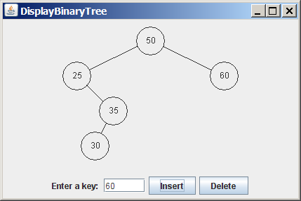
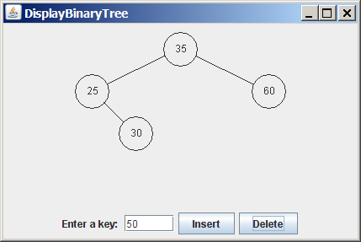
Tree Visualization
BSTAnimation
BTView

Slide 55
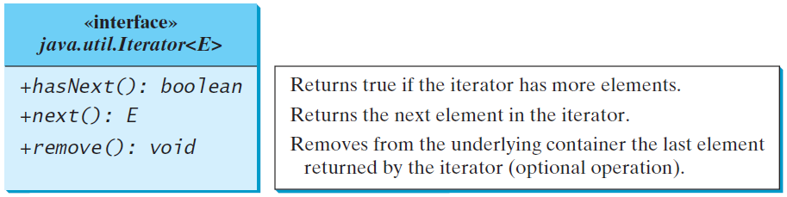
Iterators
An iterator is an object that provides a uniform way for traversing the elements in a container such as a set, list, binary tree, etc.
TestBSTWithIterator

Slide 56
Data Compression: Huffman Coding
In ASCII, every character is encoded in 8 bits. Huffman coding compresses data by using fewer bits to encode more frequently occurring characters. The codes for characters are constructed based on the occurrence of characters in the text using a binary tree, called the Huffman coding tree.

Slide 57
Constructing Huffman Tree
To construct a Huffman coding tree, use a greedy algorithm as follows:
Begin with a forest of trees. Each tree contains a node for a character. The weight of the node is the frequency of the character in the text.
Repeat this step until there is only one tree:
Choose two trees with the smallest weight and create a new node as their parent. The weight of the new tree is the sum of the weight of the subtrees.

Slide 58
Constructing Huffman Tree

Slide 59
Constructing Huffman Tree
HuffmanCode

Slide 60
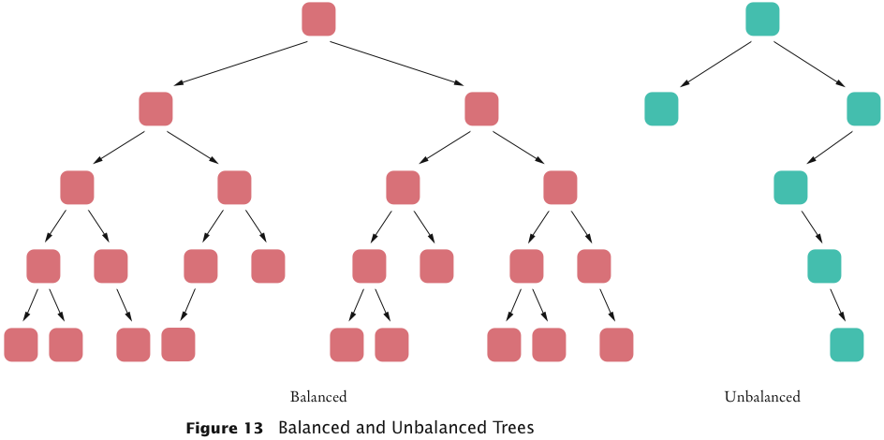
Balanced and Unbalanced Trees

Slide 61
Heaps
A heap (or, a min-heap) is a binary tree with two special properties
It is almost complete
All nodes are filled in, except the last level may have some nodes missing toward the right
The tree fulfills the heap property
All nodes store values that are at most as large as the values stored in their descendants
Heap property ensures that the smallest element is stored in the root

Slide 62
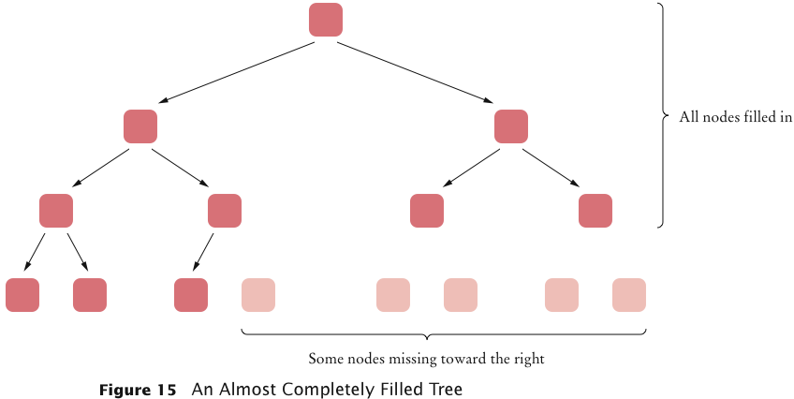
An Almost Complete Tree

Slide 63
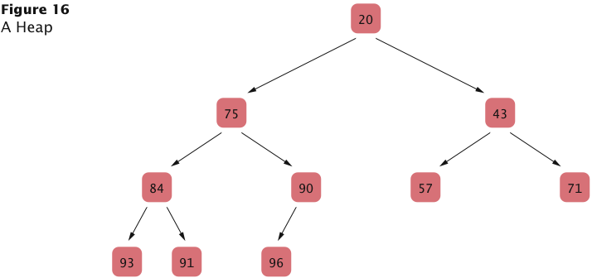
A Heap

Slide 64
Differences of a Heap with a Binary Search Tree
The shape of a heap is very regular
Binary search trees can have arbitrary shapes
In a heap, the left and right subtrees both store elements that are larger than the root element
In a binary search tree, smaller elements are stored in the left subtree and larger elements are stored in the right subtree

Slide 65
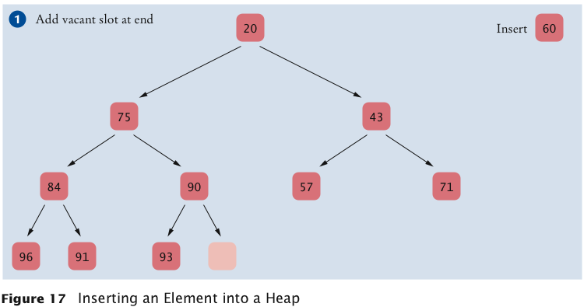
Inserting a New Element in a Heap
Add a vacant slot to the end of the tree
Continued

Slide 66
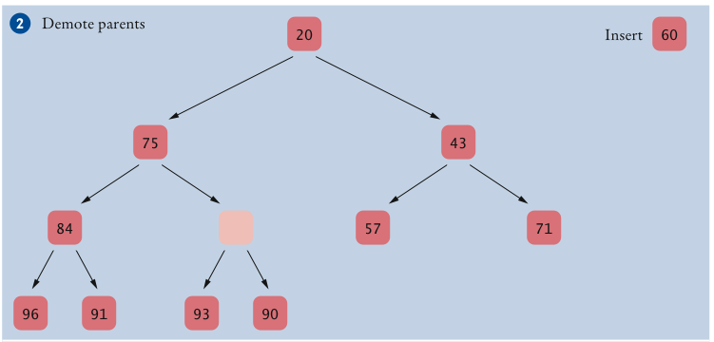
Inserting a New Element in a Heap (cont.)
Demote the parent of the empty slot if it is larger than the element to be inserted
Move the parent value into the vacant slot, and move the vacant slot up
Repeat this demotion as long as the parent of the vacant slot is larger than the element to be inserted
Continued

Slide 67
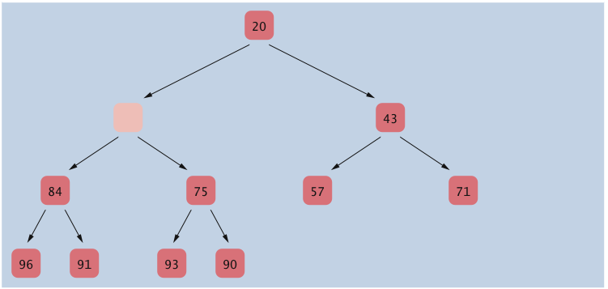
Inserting a New Element in a Heap (cont.)
Demote the parent of the empty slot if it is larger than the element to be inserted
Move the parent value into the vacant slot, and move the vacant slot up
Repeat this demotion as long as the parent of the vacant slot is larger than the element to be inserted
Continued

Slide 68
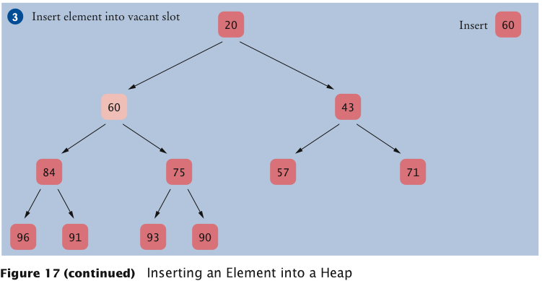
Inserting a New Element in a Heap (cont.)
At this point, either the vacant slot is at the root, or the parent of the vacant slot is smaller than the element to be inserted. Insert the element into the vacant slot

Slide 69
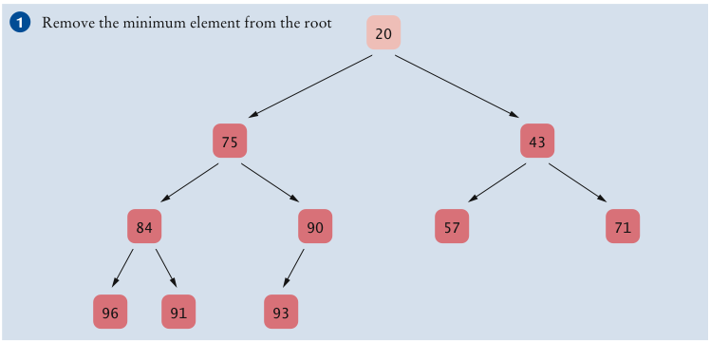
Removing an Arbitrary Node from a Heap
Extract the root node value
Continued

Slide 70
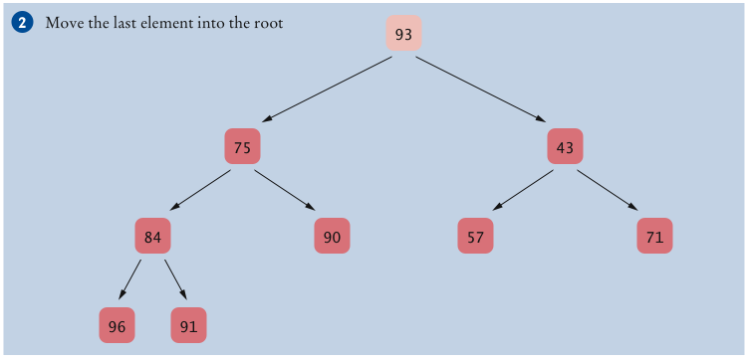
Removing an Arbitrary Node from a Heap (cont.)
Move the value of the last node of the heap into the root node, and remove the last node. Heap property may be violated for root node (one or both of its children may be smaller).
Continued

Slide 71
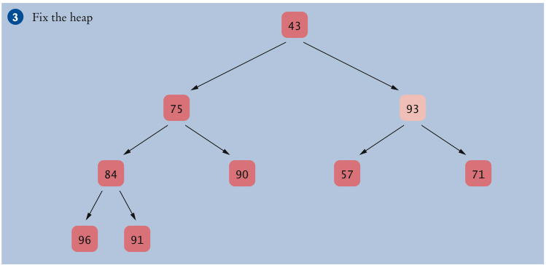
Removing an Arbitrary Node from a Heap (cont.)
Promote the smaller child of the root node. Root node again fulfills the heap property. Repeat process with demoted child. Continue until demoted child has no smaller children. Heap property is now fulfilled again. This process is called “fixing the heap”.
Continued

Slide 72
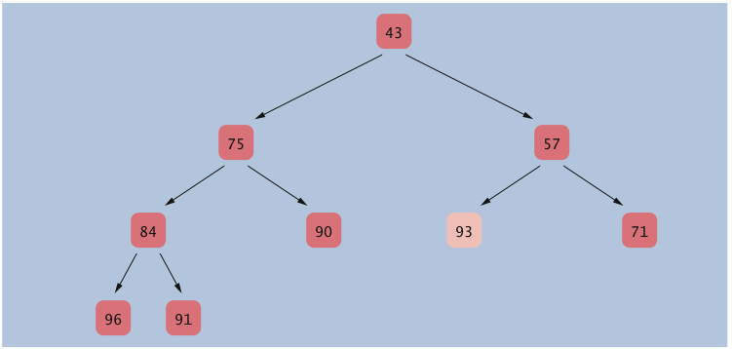
Removing an Arbitrary Node from a Heap (cont.)
Promote the smaller child of the root node. Root node again fulfills the heap property. Repeat process with demoted child. Continue until demoted child has no smaller children. Heap property is now fulfilled again. This process is called “fixing the heap”.

Slide 73
Heap Efficiency
Insertion and removal operations visit at most h nodes
h: Height of the tree
If n is the number of elements, then
2^{h–1} ≤ n < 2^{h}
or
h–1 ≤ log₂(n) < h
Thus, insertion and removal operations take O(log(n)) steps
Heap’s regular layout makes it possible to store heap nodes efficiently in an array

Slide 74
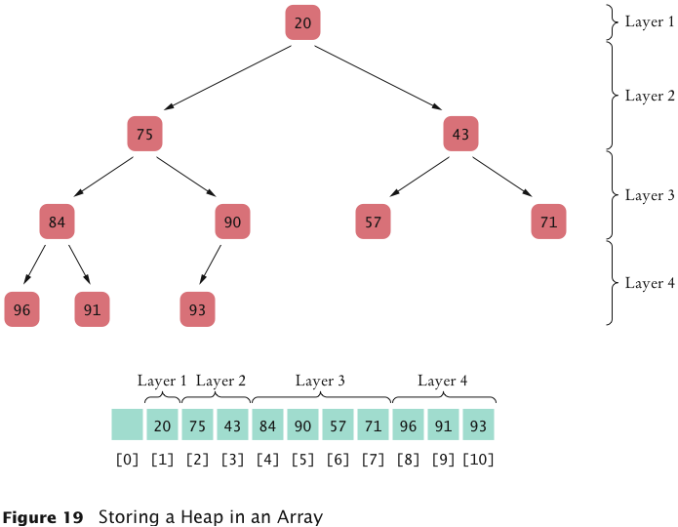
Storing a Heap in an Array

Slide 75
The Heapsort Algorithm
Based on inserting elements into a heap and removing them in sorted order
This algorithm is an O(n log(n)) algorithm:
Each insertion and removal is O(log(n))
These steps are repeated n times, once for each element in the sequence that is to be sorted

Slide 76
The Heapsort Algorithm
Can be made more efficient
Start with a sequence of values in an array and “fixing the heap” iteratively
First fix small subtrees into heaps, then fix larger trees
Trees of size 1 are automatically heaps
Begin the fixing procedure with the subtrees whose roots are located in the next-to-lowest level of the tree
Generalized fixHeap method fixes a subtree with a given root index:
void fixHeap(int rootIndex, int lastIndex)

Slide 77
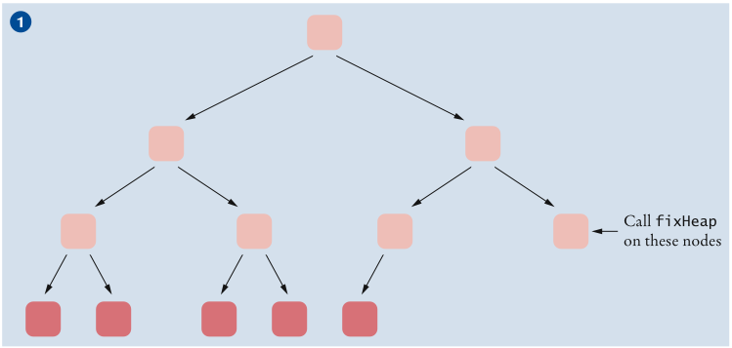
Turning a Tree into a Heap
Continued

Slide 78
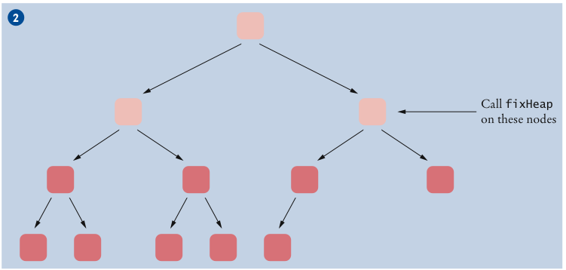
Turning a Tree into a Heap (cont.)
Continued

Slide 79
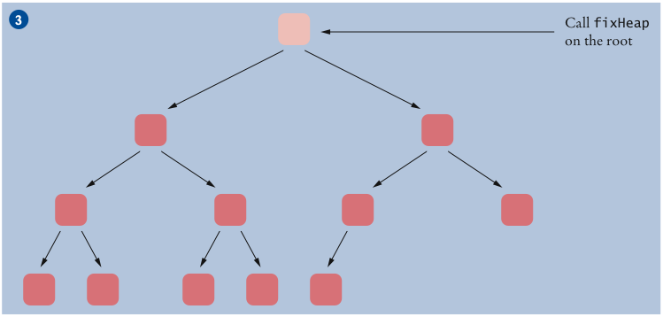
Turning a Tree into a Heap (cont.)

Slide 80
The Heapsort Algorithm
After array has been turned into a heap, repeatedly remove the root element
Swap root element with last element of the tree and then reduce the tree length
Removed root ends up in the last position of the array, which is no longer needed by the heap
We can use the same array both to hold the heap (which gets shorter with each step) and the sorted sequence (which gets longer with each step)
Use a max-heap rather than a min-heap so that sorted sequence is accumulated in the correct order

Slide 81
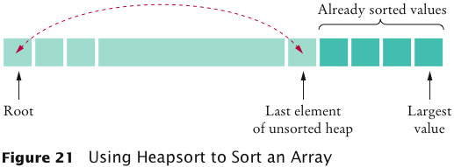
Using Heapsort to Sort an Array

Slide 82
ch16/heapsort/HeapSorter.java
1 /**
2 This class applies the heapsort algorithm to sort an array.
3 */
4 public class HeapSorter
5 {
6 private int[] a;
7
8 /**
9 Constructs a heap sorter that sorts a given array.
10 @param anArray an array of integers
11 */
12 public HeapSorter(int[] anArray)
13 {
14 a = anArray;
15 }
16
Continued

Slide 83
ch16/heapsort/HeapSorter.java (cont.)
17 /**
18 Sorts the array managed by this heap sorter.
19 */
20 public void sort()
21 {
22 int n = a.length - 1;
23 for (int i = (n - 1) / 2; i >= 0; i--)
24 fixHeap(i, n);
25 while (n > 0)
26 {
27 swap(0, n);
28 n--;
29 fixHeap(0, n);
30 }
31 }
32
Continued

Slide 84
ch16/heapsort/HeapSorter.java (cont.)
33 /**
34 Ensures the heap property for a subtree, provided its
35 children already fulfill the heap property.
36 @param rootIndex the index of the subtree to be fixed
37 @param lastIndex the last valid index of the tree that
38 contains the subtree to be fixed
39 */
40 private void fixHeap(int rootIndex, int lastIndex)
41 {
42 // Remove root
43 int rootValue = a[rootIndex];
44
45 // Promote children while they are larger than the root
46
47 int index = rootIndex;
48 boolean more = true;
49 while (more)
50 {
51 int childIndex = getLeftChildIndex(index);
52 if (childIndex <= lastIndex)
53 {
54 // Use right child instead if it is larger
55 int rightChildIndex = getRightChildIndex(index);
56 if (rightChildIndex <= lastIndex
57 && a[rightChildIndex] > a[childIndex])
58 {
59 childIndex = rightChildIndex;
60 }
Continued

Slide 85
ch16/heapsort/HeapSorter.java (cont.)
61
62 if (a[childIndex] > rootValue)
63 {
64 // Promote child
65 a[index] = a[childIndex];
66 index = childIndex;
67 }
68 else
69 {
70 // Root value is larger than both children
71 more = false;
72 }
73 }
74 else
75 {
76 // No children
77 more = false;
78 }
79 }
80
81 // Store root value in vacant slot
82 a[index] = rootValue;
83 }
84
Continued

Slide 86
ch16/heapsort/HeapSorter.java (cont.)
85 /**
86 Swaps two entries of the array.
87 @param i the first position to swap
88 @param j the second position to swap
89 */
90 private void swap(int i, int j)
91 {
92 int temp = a[i];
93 a[i] = a[j];
94 a[j] = temp;
95 }
96
97 /**
98 Returns the index of the left child.
99 @param index the index of a node in this heap
100 @return the index of the left child of the given node
101 */
102 private static int getLeftChildIndex(int index)
103 {
104 return 2 * index + 1;
105 }
106
Continued

Slide 87
ch16/heapsort/HeapSorter.java (cont.)
107 /**
108 Returns the index of the right child.
109 @param index the index of a node in this heap
110 @return the index of the right child of the given node
111 */
112 private static int getRightChildIndex(int index)
113 {
114 return 2 * index + 2;
115 }
116 }

Slide 88
Self Check 16.17
Which algorithm requires less storage, heapsort or mergesort?
Answer: Heapsort requires less storage because it doesn’t need an auxiliary array.

Slide 89
Self Check 16.18
Why are the computations of the left child index and the right child index in the HeapSorter different than in MinHeap?
Answer: The MinHeap wastes the 0 entry to make the formulas more intuitive. When sorting an array, we don’t want to waste the 0 entry, so we adjust the formulas instead.

